Slide 1
UNIT V – SDN Implementation and Mobile Networks
SESSION 1
  SDN Open Source-
  Chapter-Specific Terminology
  Open Source Licensing Issues
  Profiles of SDN Open Source Users
  OpenFlow Source Code
  Reference: Ref. 1, Ch.11.1 to 11.4

Slide 2
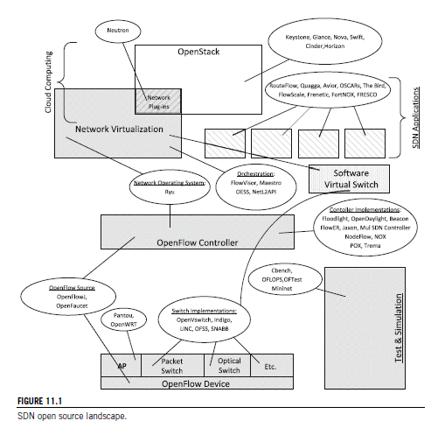
Open flow landscape

Slide 3
Chapter-Specific Terminology
Forking:
Forking is to take the source code from an open source software program and develop an entirely new program.
Forking is often the result of a deadlock in an open source project that is so insurmountable that all work stops.
When a new code base is forked from an existing release, it cuts the connection back to the trunk. This means that the continuing innovation on that fork will not be contributed back to the original code base.

Slide 4
Open Source Licensing Issues
open source means it is source code provided without charge and that you may use and modify for a defined set of purposes. There is open source available that only allows non-commercial use.
Even when commercial use is allowed, however, there are significant differences in the obligations implicit in the use of such software.
Some major categories of open source licensing in widespread commercial use today are the GNU General Public License (GPL), BSD style, and Apache.
There are different organizations that opine on whether a given license is truly open source.
These groups include the Free Software Foundation (FSF) and the Open Source Initiative. They do not always agree.

Slide 5
GPL
GPL is an extremely popular licensing form. The Linux operating system is distributed under the GPL license. It allows users to copy and modify the software for virtually any purpose.
For many companies, though, GPL is too restrictive in one major facet. It incorporates the notion of copyleft, whereby if any derivative works are distributed, they must be distributed under the same license.
If a commercial company extends a GPL open source code base to provide some new function that it wants to offer to the market, the modifications that are made must be made freely available to the open source community under GPL terms.
If the function provided by the GPL open source can be used with little added intellectual property, GPL code may be suitable in commercial products. Ensuring that this distinction is kept clear can have massive consequences on the valuation that a startup receives from investors. For this reason, GPL open source is used with caution in industry.
Nonetheless, GPL remains the most widely used free software license. There is a GPL V.2 and GPL V.3 that are somewhat more restrictive than the initial version.

Slide 6
BSD
The BSD-family licensing model is more permissive. This style of license was first used for the Berkeley Software Distribution (BSD), a Unix-like operating system.
There have been a number of variants of this original license since its first use; hence we use here the term BSD family of licenses.
Unlike GPL code, the user is under no obligation to contribute derivative works back to the open source community.
This makes it much less risky to incorporate BSD-licensed open source into commercial products.
In some versions of this style of license, the advertising clause originally required to acknowledge the use of U.C. Berkeley code in any advertisement of the product.
Although this requirement has been eliminated in the latest versions of the BSD license, there are still many free software products licensed with a similar restriction.
An example is the widely used OpenSSL encryption library, which requires acknowledgment of the author in product advertising.

Slide 7
Apache
The Apache license is another permissive license form for open source.
The license was developed by the Apache Software Foundation (ASF) and is used for software produced by the ASF as well as some non-ASF entities.
Software provided under the Apache license is unrestricted in use except for the requirement that the copyright notice and disclaimer be maintained in the source code itself.
Because this restriction has minimal impact on potential commercialization of such software, many commercial entities build products freely incorporating Apache-licensed source code today.

Slide 8
EPL
The Eclipse Public License (EPL) can be viewed as a compromise between the strong copyleft aspects of the GPL and the commercially friendly Apache license.
Under certain circumstances, using EPL-licensed source code can result in an obligation to contribute one’s own modifications back to the open source community.
This is not a universal requirement, though, so developers can often incorporate this software into commercial products without risk of being forced to expose their own intellectual property to the entire open source community.
The requirement comes into effect when the modifications are not a separate software module but contain a significant part of the EPL-licensed original and are thus a derivative work.
Even when the requirement to release extensions to the original is not in effect, the user is required to grant a license to anyone receiving their modification to any patent the user may hold over those modifications.

Slide 9
FOSS
The Stanford University Free and Open Source Software (FOSS) license is noteworthy in the manner in which it attempts to address the common problem with commercial use of GPL-licensed source code due to its copyleft provision.
Stanford’s motivation in developing this concept was to avoid the situation where developers would hesitate to develop applications for the Beacon controller.
Because of the way in which applications interface with the Beacon controller, if it were licensed under GPL without the FOSS exception, such developers would be obliged to contribute their work as GPL open source.
This license is specific to the Beacon controller, though the concept can be applied more generally.
In essence, Stanford wants to release the Beacon controller code under the terms of GPL.
FOSS specifies that a user of the code must continue to treat the Beacon code itself under the terms of GPL, but the code they write as a Beacon application can be released under any of a number of approved FOSS licenses.

Slide 10
Profiles of SDN Open Source Users
Three broad categories of likely users of SDN-related open source software:
Research
Commercial developers
Network operators
Developer in a commercial enterprise will focus on ensuring that he/she does not incorporate any open source that will limit his/her company’s ability to exploit its products commercially and ensuring that it will protect its intellectual property.
Researchers have the greatest flexibility and simply desire that the source code be available free of charge and can be modified and distributed for any purpose. Researchers are also strong proponents of the growth of open source and, thus, may prefer a copy_x0002_left license that obliges the users to contribute their modifications back to the open source community.
Network operator will be most concerned about maintaining the network in an operational state and therefore will focus on how the open source product will be supported and how robust it is.

Slide 11
OpenFlow Source Code
There are multiple open source implementations of OpenFlow
Table 1 provide a basic description of available implementations;
Table 2 list detailed information regarding the provider of the code, the type of license, the source code in which it is written (where relevant), and the likely class(es) of users.
We have assigned these target classes of users using a number of criteria, including: (1) the nature of the license, (2) the maturity of the code, and (3) actual users, when known.
OpenFlowJ is notable in that the Beacon controller, itself the fount of a number of other controller implementations, uses the OpenFlowJ code.
In some cases the license or language may not be known. We indicate this by placing a hyphen in the corresponding table cell.
We also mark the table cell with a hyphen for languages in the event that the project uses multiple languages

Slide 12
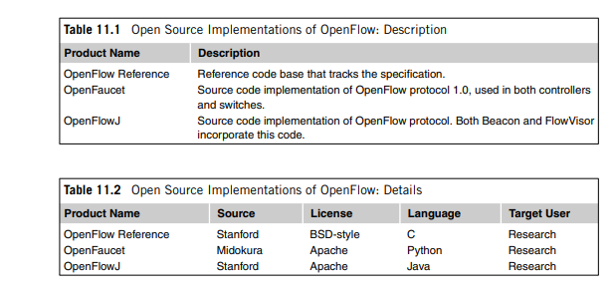
OpenFlow Source Code

